Slide 1
Greedy Algorithms
Course Code: CSC2211
Course Title: Algorithms
Dept. of Computer Science
Faculty of Science and Technology
Lecturer No: | 04 | Week No: | 06 | Semester:
Lecturer: | Name & email: Dr. Abdus Salam, abdus.salam@aiub.edu

Slide 2
Algorithm Design Techniques
Incremental
Ex: Insertion Sort, Selection Sort, Bubble Sort
Divide and conquer
Ex: Merge Sort, Quick Sort, Binary Search
Greedy
Ex: Activity Selection, Coin Change, Fractional Knapsack
Dynamic Programming
Ex: 0/1 Knapsack, Matrix Chain Multiplication, Longest Common Subsequence

Slide 3
Optimization Problems
An optimization problem is one in which you want to find, not just a solution, but the best solution.
Example
Graph coloring optimization problem: given an undirected graph, G= (V,E), what is the minimum number of colors required to assign “colors” to each vertex in such a way that no two adjacent vertices have the same color.
Path optimization problem: Find the shortest path(s) from u to v in a given graph G.
a
b
Find all the shortest paths from a to d:
a →b →d
a →c →d
d
c

Slide 4
Greedy Algorithm
Solves an optimization problem
For many optimization problems, greedy algorithm can be used. (not always)
Greedy algorithm for optimization problems typically go through a sequence of steps, with a set of choices at each step. Current choice does not depend on evaluating potential future choices or pre-solving repeatedly occurring subproblems (a.k.a., overlapping subproblems). With each step, the original problem is reduced to a smaller problem.
Greedy algorithm always makes the choice that looks best at the moment.
It makes a locally optimal choice in the hope that this choice will lead to a globally optimal solution.

Slide 5
Optimal Solution
What is an Optimal Solution?
Given a problem, more than one solution exist
One of the solution is the best based on some given constraints, that solution is called the optimal solution
What is Global Optimal Solution?
Optimal Solution to the main problem
What is local Optimal Solution?
Optimal Solution to the sub-problems

Slide 6
Example of Greedy Algorithms
Activity Selection Problem
Coin Changing Problem
Job Scheduling Problem
Fractional Knapsac Problem
Dijkstra’s Shortest Path Problem
Minimum Spanning Tree Problem

Slide 7
Coin changing problem
Definition
Given coin denominations in {C }, make change for a given amount
A with the minimum number of coins.
Example:
Coin denominations, C = {25,10,5,1} Amount to change, A = 73
Licensed under
CSE 221: Algorithms
Choose 2 25 coins, so remaining is 73 − 2 ∗ 25 = 23
Choose 2 10 coins, so remaining is 23 − 2 ∗ 10 = 3
Choose 0 5 coins, so remaining is 3
Choose 3 1 coins, so remaining is 3 − 3 ∗ 1 = 0
Solution (and it’s optimal): 2 × 25 + 2 × 10 + 3 × 1 = 7 coins
Key Question
Does a greedy approach always produce the optimal solution?
34 / 38

Slide 8
Coin changing problem
Coin denominations, C = {12, 5, 1} Amount to change, A = 15
Example (using greedy strategy)
Choose 1 12 coins, so remaining is 15 − 1 ∗12 = 3
Choose 3 1 coins, so remaining is 3 − 1 ∗ 3 = 0
Licensed under
CSE 221: Algorithms
Solution: 4 coins.
Example (using optimal strategy)
Choose 0 12 coins, so remaining is 15
Choose 3 5 coins, so remaining is 15 − 3 ∗ 5 = 0
Solution: 3 coins.
Correctness depends on the choice of coins,
so greedy strategy does not provide a general solution to this problem!
35 / 38

Slide 9
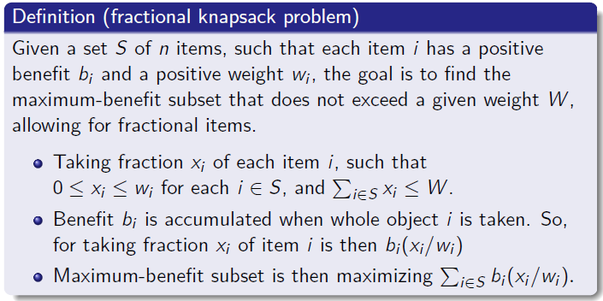
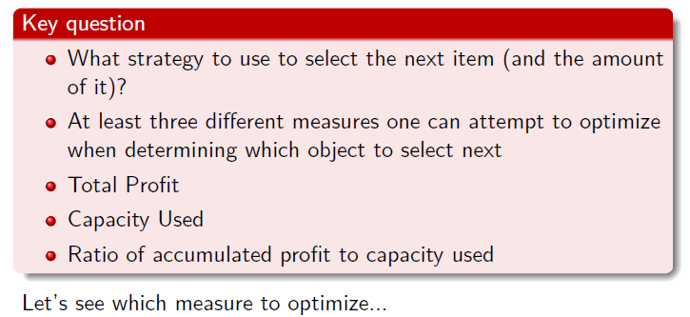
Fractional knapsack problem
24 / 38

Slide 10
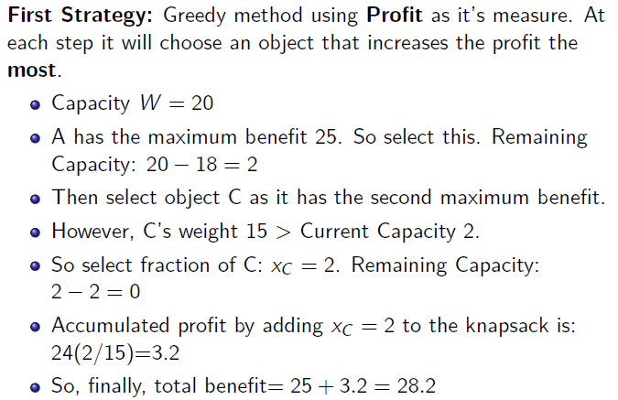
Fractional knapsack problem
Item | Benefit | Weight
A | 25 | 18 kg
B | 15 | 10 kg
C | 24 | 15 kg
Capacity W=20

Slide 11
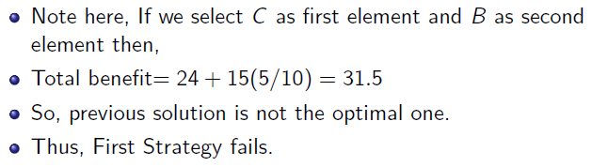
Fractional knapsack problem
Item | Benefit | Weight
A | 25 | 18 kg
B | 15 | 10 kg
C | 24 | 15 kg
Licensed under
CSE 221: Algorithms
27 / 38

Slide 12
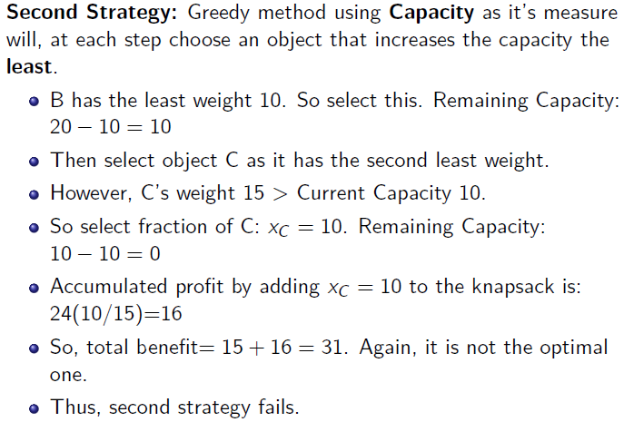
Fractional knapsack problem
Licensed under
CSE 221: Algorithms
28 / 38

Slide 13
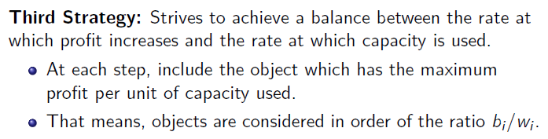
Fractional knapsack problem
Licensed under
CSE 221: Algorithms
13 / 38

Slide 14
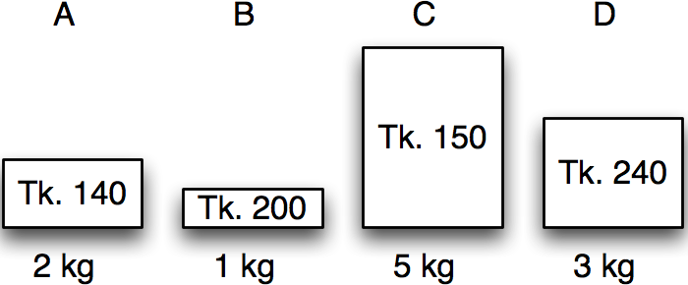
Greedy algorithms
Fractional knapsack problem
Item | Benefit | Weight
A | 140 | 2 kg
B | 200 | 1 kg
C | 150 | 5 kg
D | 240 | 3 kg
Calculate benefit/kg – the value index.

Slide 15
Greedy algorithms
Fractional knapsack problem
Item | Benefit | Weight | Value index
A | 140 | 2 kg | 70
B | 200 | 1 kg | 200
C | 150 | 5 kg | 30
D | 240 | 3 kg | 80
Sort by non-increasing value index.
Licensed under
30 / 38

Slide 16
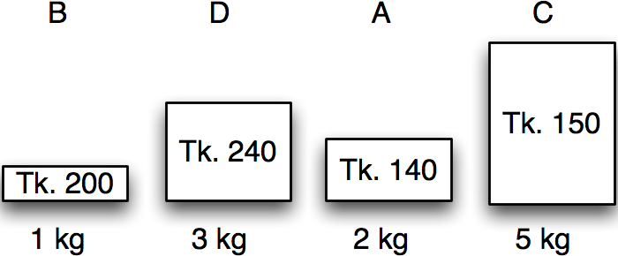
Greedy algorithms
Fractional knapsack problem
Item | Benefit | Weight | Value index
B | 200 | 1 kg | 200
D | 240 | 3 kg | 80
A | 140 | 2 kg | 70
C | 150 | 5 kg | 30
Maximum weight:
5 kg
30 / 38

Slide 17
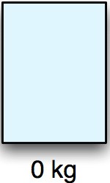
Greedy algorithms
Fractional knapsack problem
Item | Benefit | Weight | Value index | Chosen
B | 200 | 1 kg | 200 | 0 kg
D | 240 | 3 kg | 80 | 0 kg
A | 140 | 2 kg | 70 | 0 kg
C | 150 | 5 kg | 30 | 0 kg
Maximum weight:
5 kg
Remaining:
5 kg
Benefit:
0
30 / 38

Slide 18
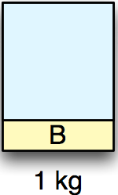
Greedy algorithms
Fractional knapsack problem
Item | Benefit | Weight | Value index | Chosen
B | 200 | 1 kg | 200 | 1 kg
D | 240 | 3 kg | 80 | 0 kg
A | 140 | 2 kg | 70 | 0 kg
C | 150 | 5 kg | 30 | 0 kg
Maximum weight:
5 kg
Remaining:
4 kg
Benefit:
200
30 / 38

Slide 19
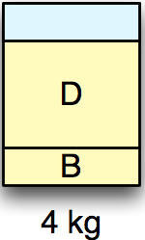
Greedy algorithms
Fractional knapsack problem
Item | Benefit | Weight | Value index | Chosen
B | 200 | 1 kg | 200 | 1 kg
D | 240 | 3 kg | 80 | 3 kg
A | 140 | 2 kg | 70 | 0 kg
C | 150 | 5 kg | 30 | 0 kg
Maximum weight:
5 kg
Remaining:
1 kg
Benefit:
440
30 / 38

Slide 20
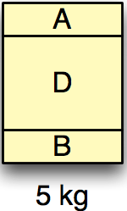
Greedy algorithms
Fractional knapsack problem
Item | Benefit | Weight | Value index | Chosen
B | 200 | 1 kg | 200 | 1 kg
D | 240 | 3 kg | 80 | 3 kg
A | 140 | 2 kg | 70 | 1 kg
C | 150 | 5 kg | 30 | 0 kg
Maximum weight:
5 kg
Remaining:
0 kg
Benefit:
510
30 / 38

Slide 21
Greedy algorithms
Fractional knapsack problem
Item | Benefit | Weight | Value index | Chosen
B | 200 | 1 kg | 200 | 1 kg
D | 240 | 3 kg | 80 | 3 kg
A | 140 | 2 kg | 70 | 1 kg
C | 150 | 5 kg | 30 | 0 kg
Maximum weight:
5 kg
Remaining:
0 kg
Benefit:
510
30 / 38

Slide 22
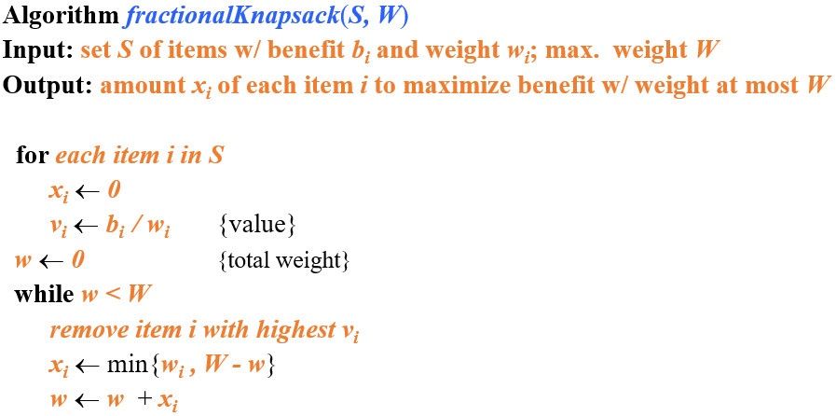
Fractional knapsack problem

Slide 23
Fractional knapsack problem
Running time:
Given a collection S of n items, such that each item i has a benefit b_{i} and weight w_{i}, we can construct a maximum-benefit subset of S, allowing for fractional amounts, that has a total weight W in O(nlogn) time. (how?)
Use heap-based priority queue to store S
Removing the item with the highest value takes O(logn) time
In the worst case, need to remove all items

Slide 24
Fractional knapsack problem
Exercise
Assume that we have a knapsack with max weight capacity, W = 16. our objective is to fill the knapsack with items such that the benefit (value or profit) is maximum. Consider the following items and their associated weight and value
ITEM | WEIGHT | VALUE
i1 | 6 | 6
i2 | 10 | 2
i3 | 3 | 1
i4 | 5 | 8
i5 | 1 | 3
i6 | 3 | 5

